Slide 1
CORONAVIRUS PANDEMIC
AND ITS IMPACT ON UNITED STATES’ AND CHINA’S ECONOMY
We will analyze the impact the Wuhan Coronavirus pandemic
is having on US and Chinese stock markets.
Our results will help predict a way to manage portfolios during a pandemic.

Slide 2
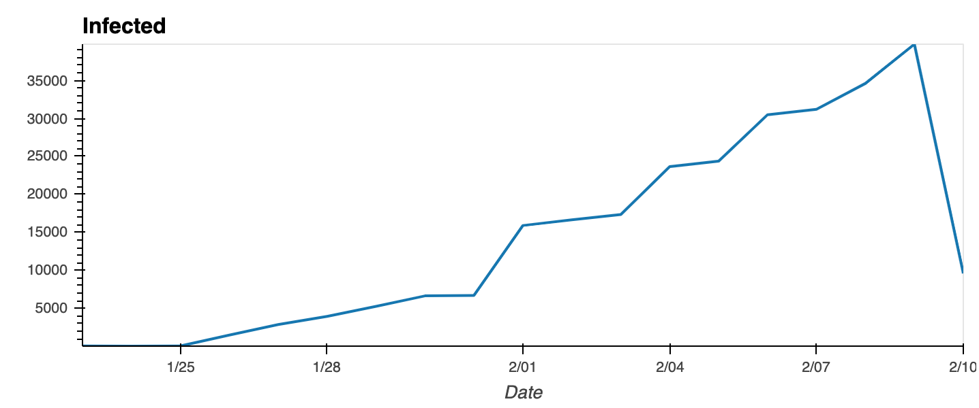
The Wuhan-centered outbreak, which first began in December 2019, is expected to continue to spread widely within China, with additional cases exported to other countries.

Slide 3
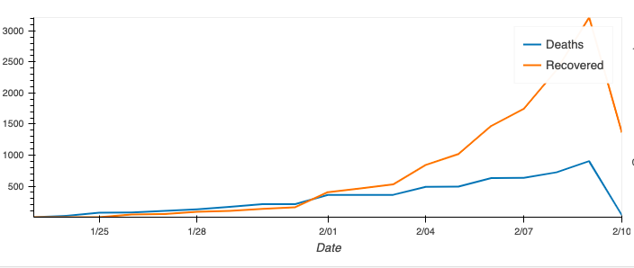
Death and Recovery Rates Per Day in China

Slide 4
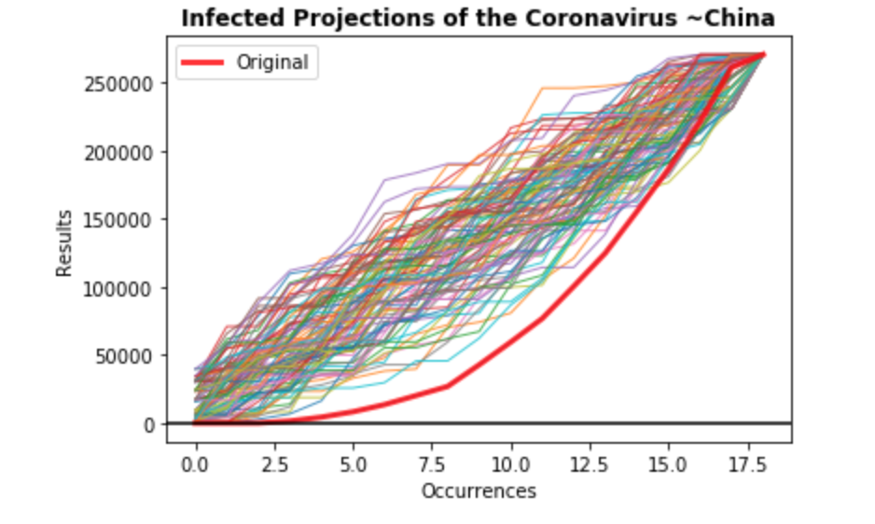
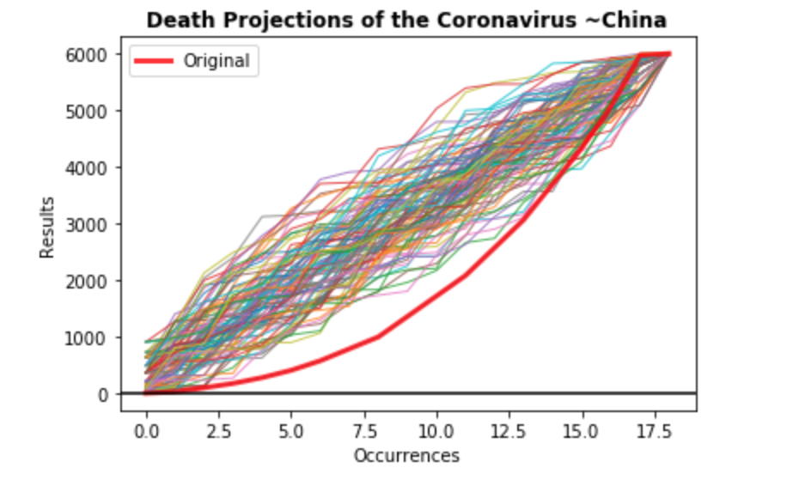
We projected the growth of the ‘Infected’ and ‘Death’ rates for China

Slide 5
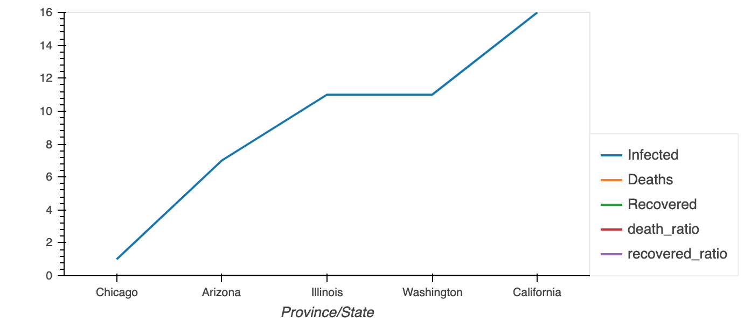
The risk remains very low to the United States with only TWELVE ‘Infected’ cases and ZERO ‘Deaths’ reported to this day.

Slide 6
We determined the top 5 markets affected by the outbreak in the
US and CHINA

Slide 7
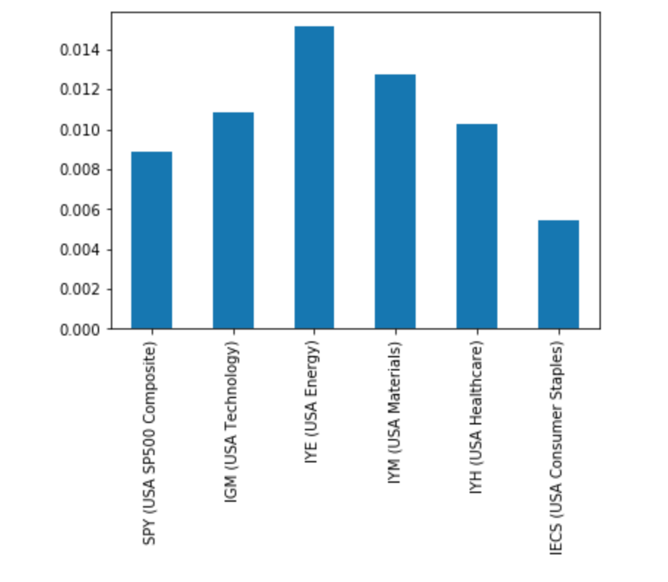
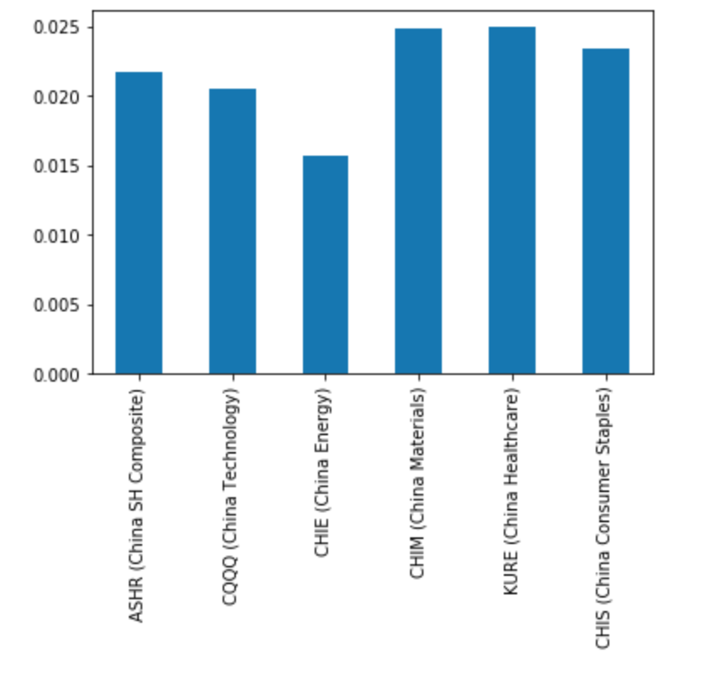
TECH, ENERGY, MATERIALS, HEALTHCARE AND CONSUMER STAPLES

Slide 8
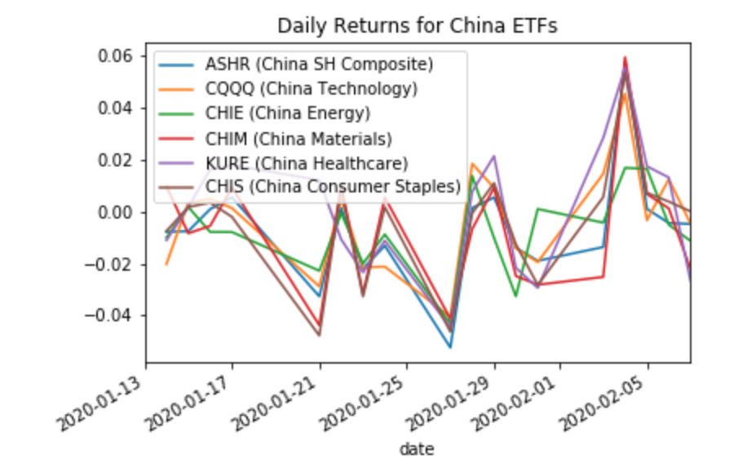
We took a look at China’s Top 5 Markets at the beginning of the outbreak to decide which were affected negatively and positively.

Slide 9
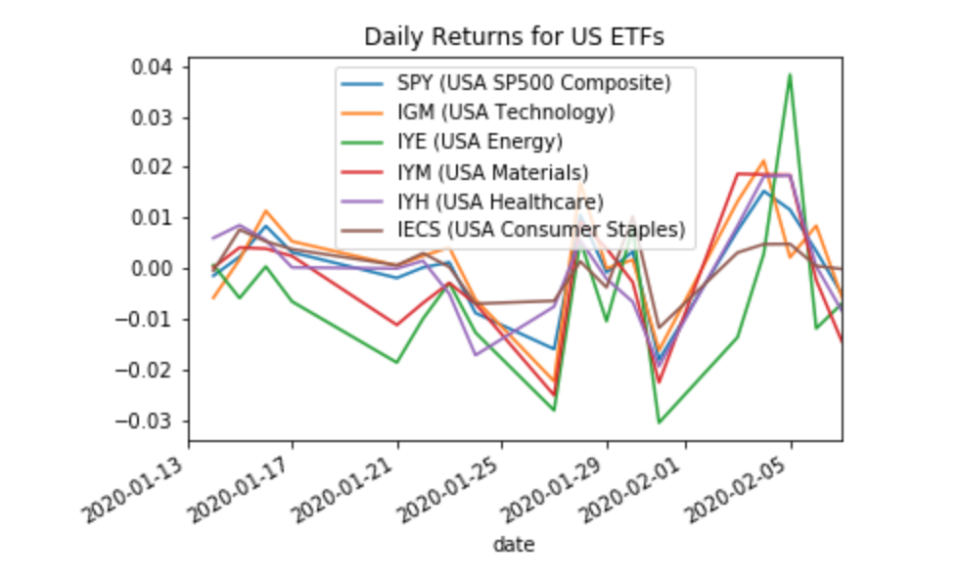
We also took the Daily Returns for the Top 5 US Stock Markets and SP500 to determine any correlations between the growth of the virus and the increase or decrease of stock value.

Slide 10
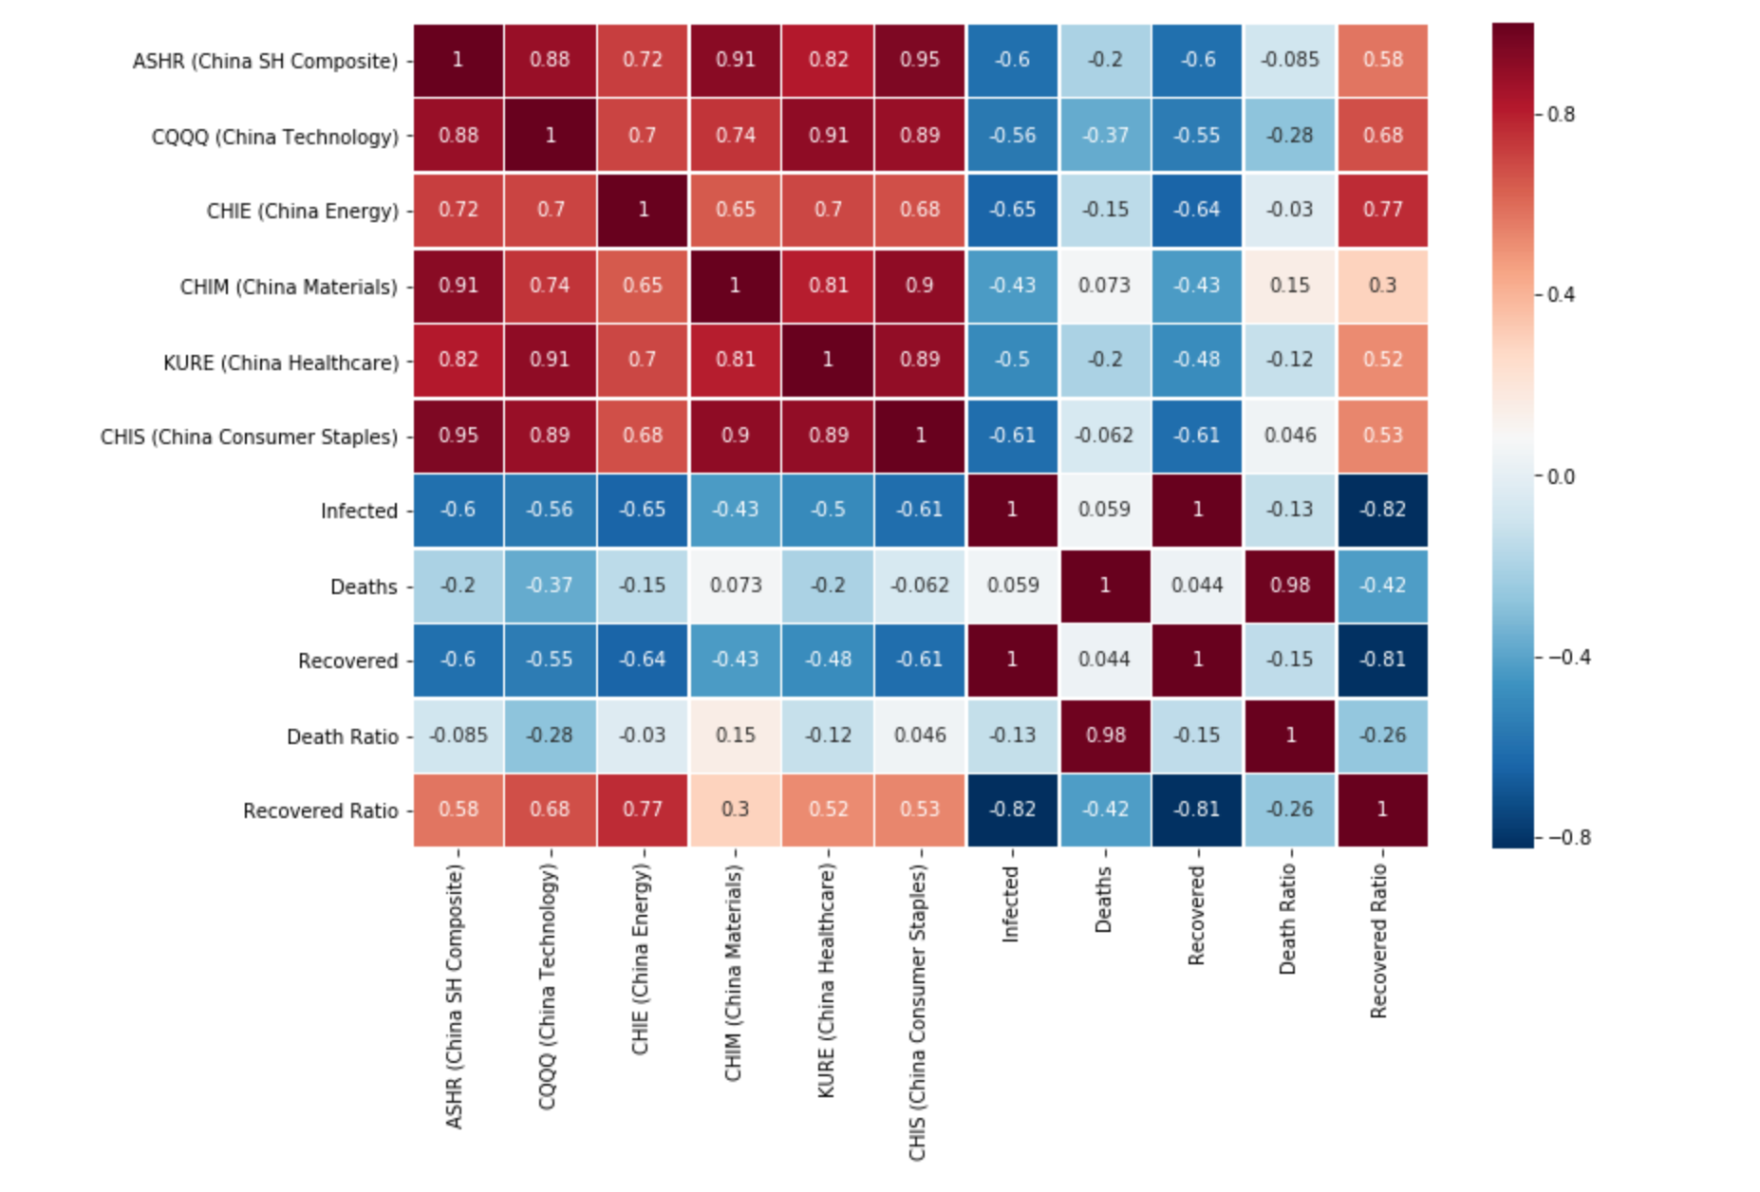
China to Coronavirus Correlations

Slide 11
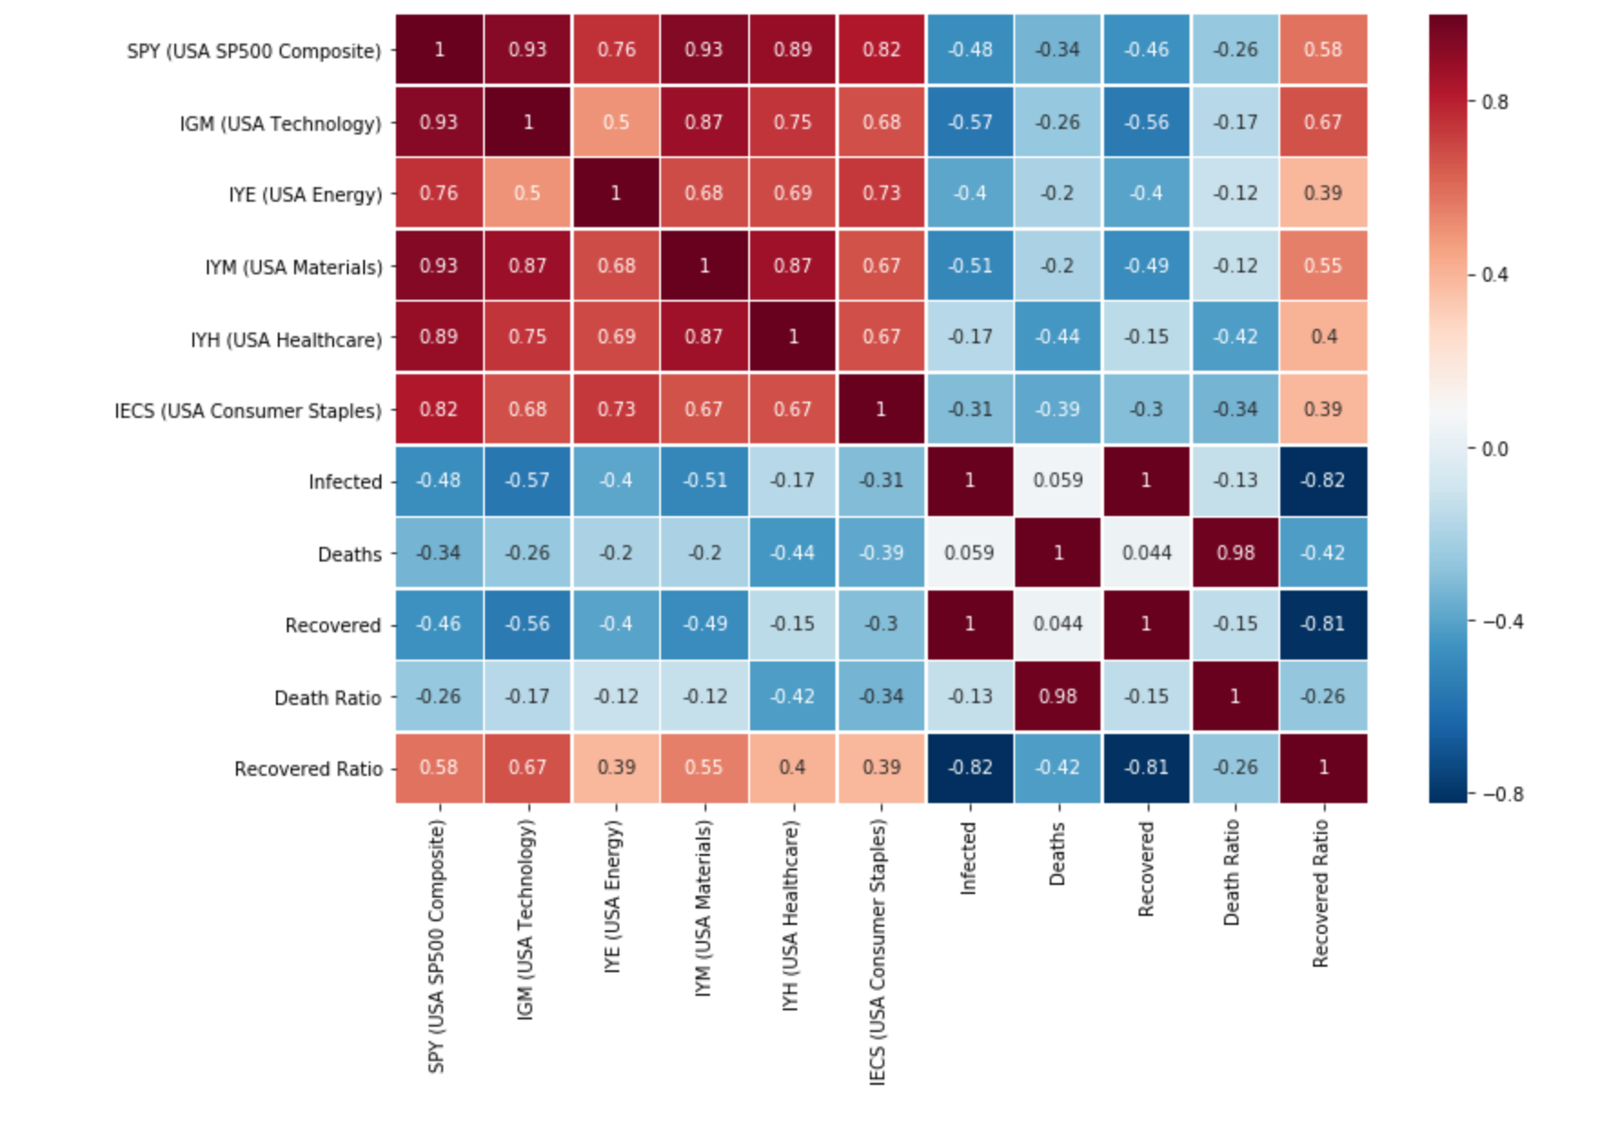
USA to Coronavirus Correlations

Slide 12
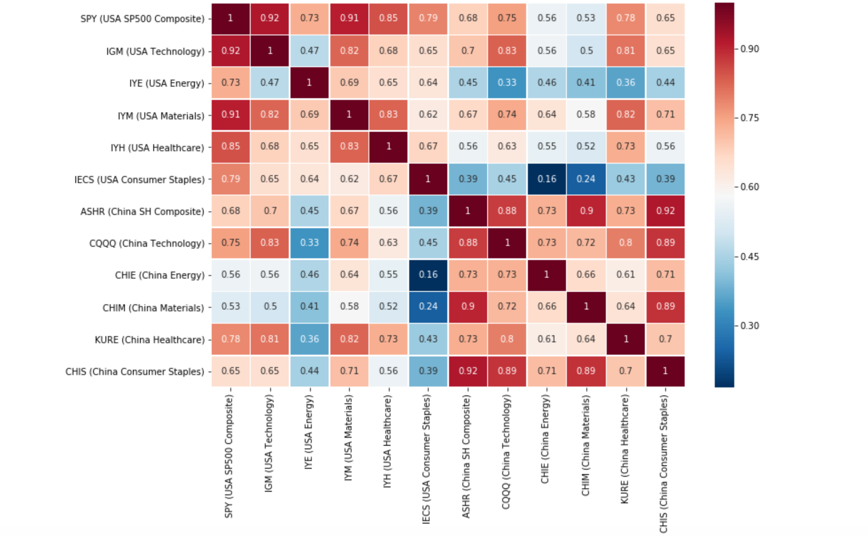
Correlation between China and US Top 5 Stock Markets

Slide 13
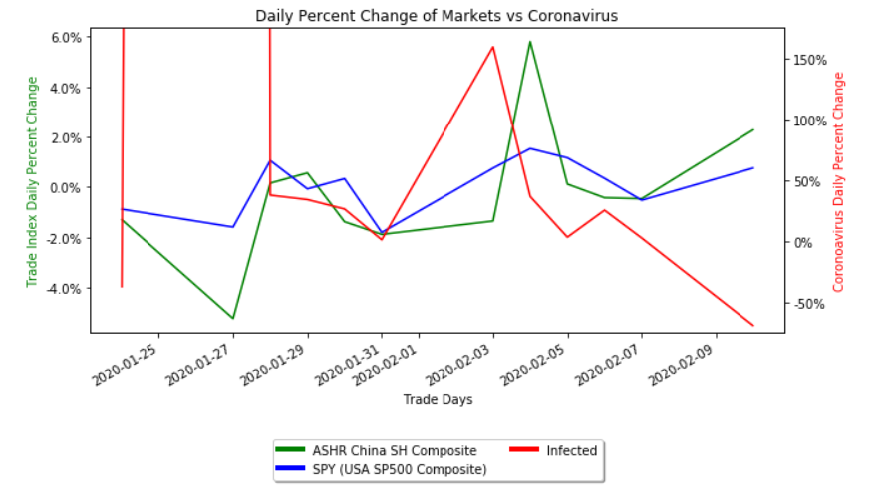
Infection Rate to Market Change

Slide 14
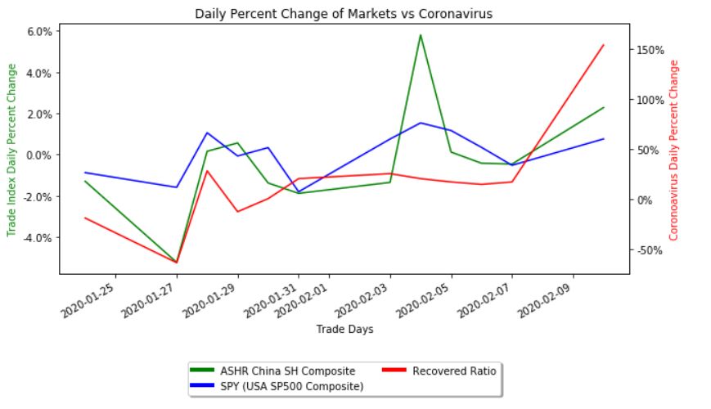
Recovery Rate to Market change

Slide 15
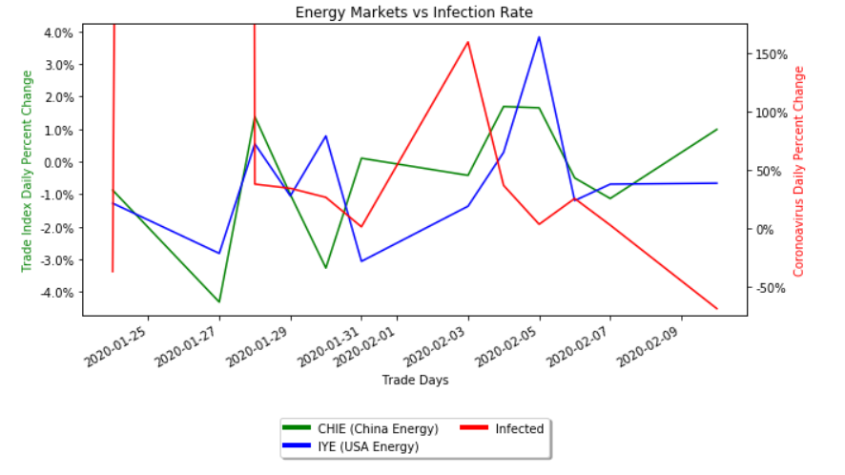
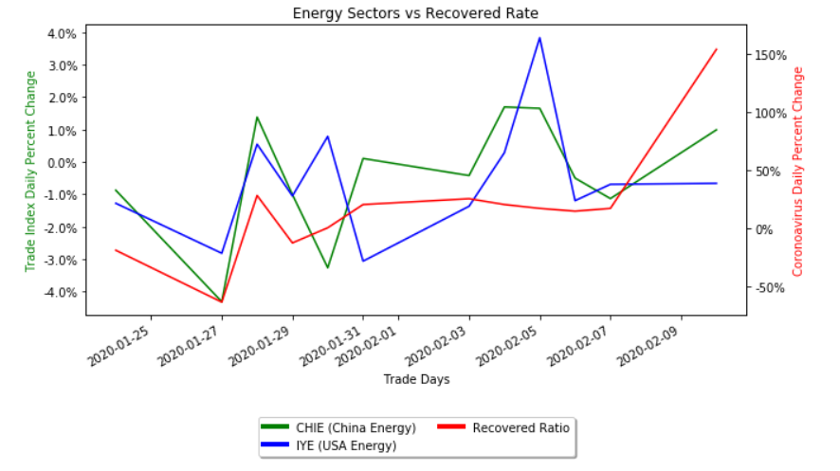
ENERGY

Slide 16
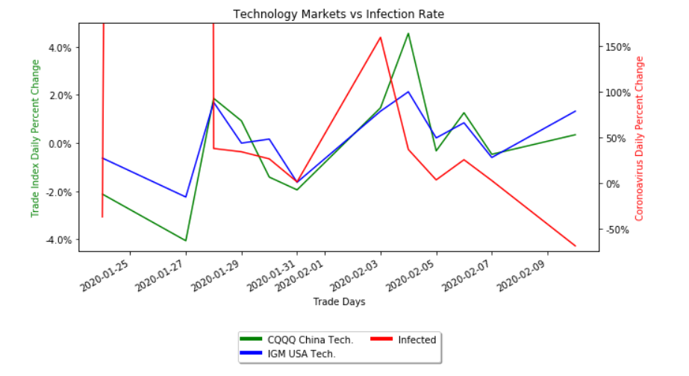
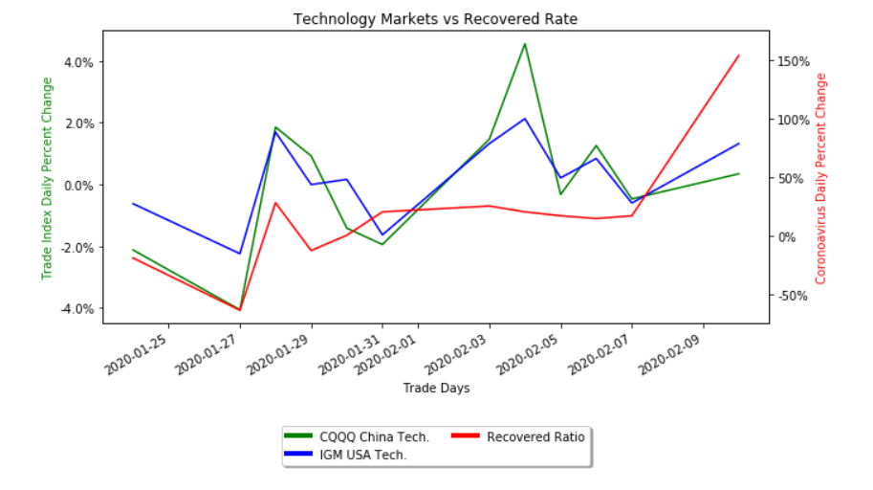
TECH

Slide 17
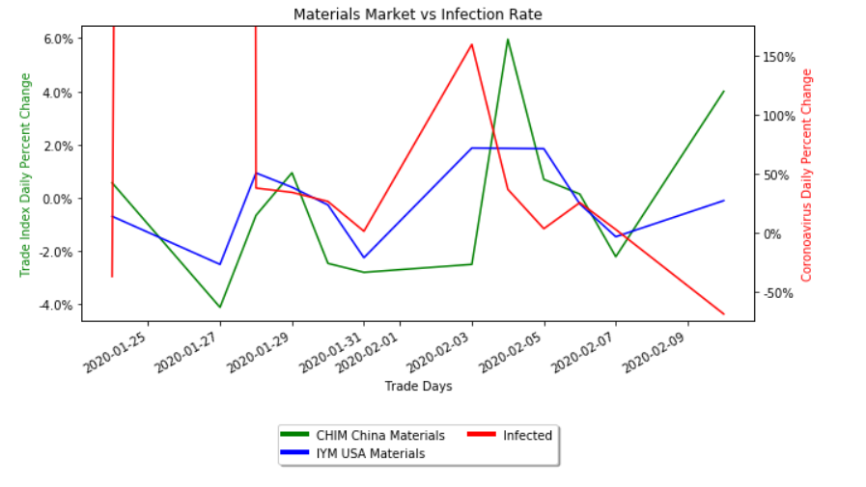
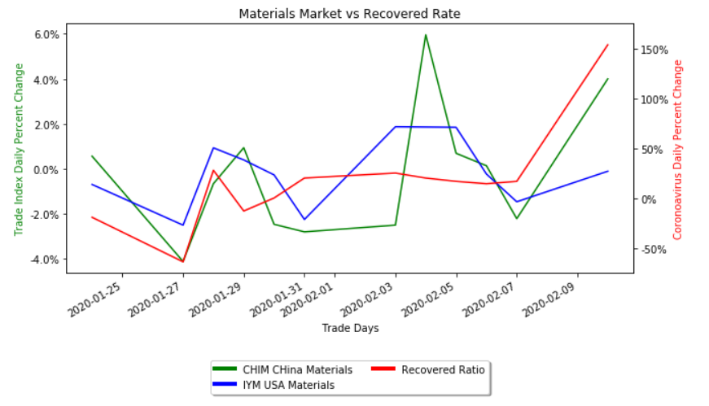
MATERIALS

Slide 18
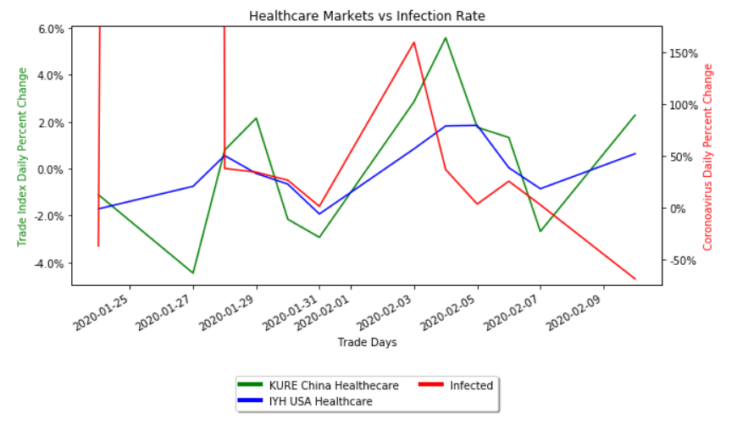
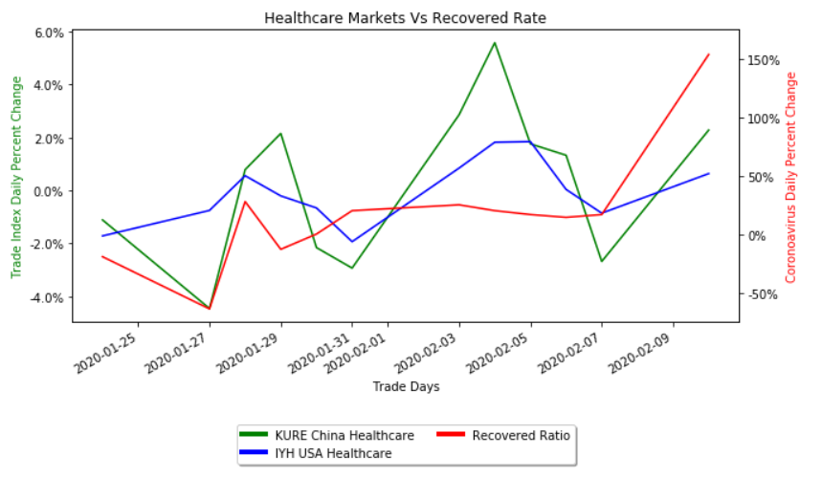
HEALTHCARE

Slide 19
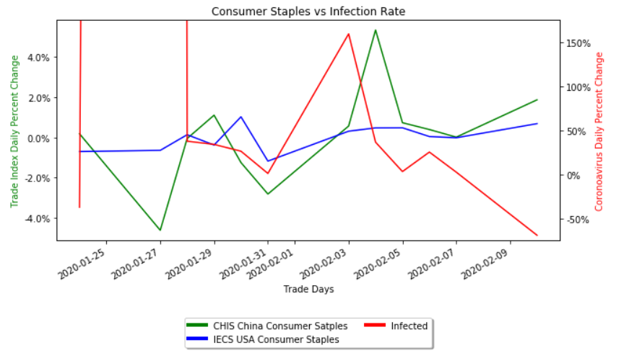
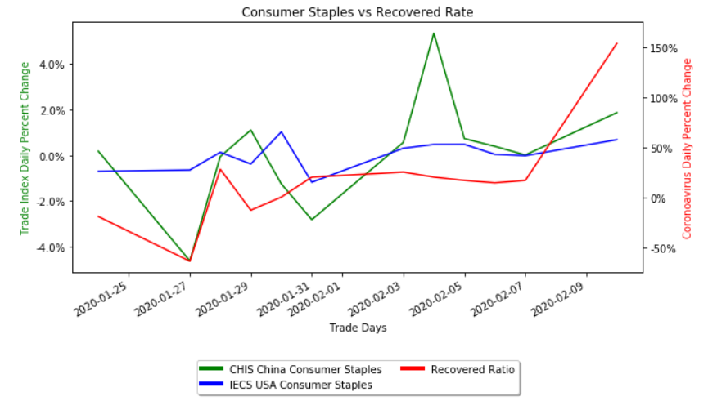
CONSUMER STAPLES

Slide 20
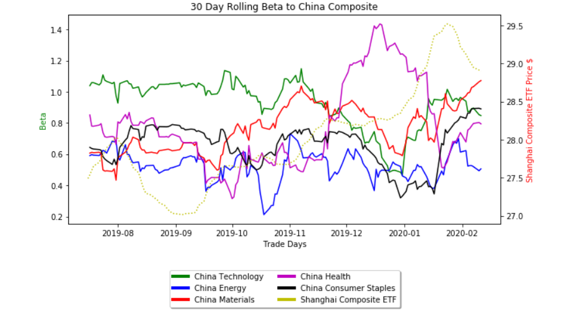
Beta for China Stock Market

Slide 21
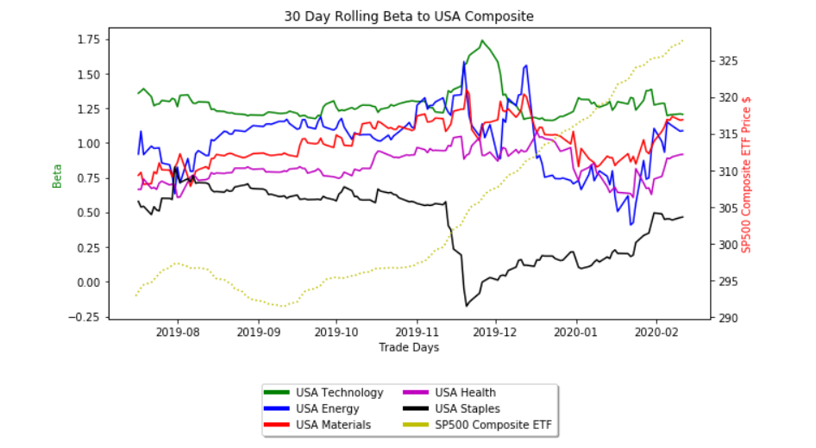
Beta for USA Stock Market

Slide 22
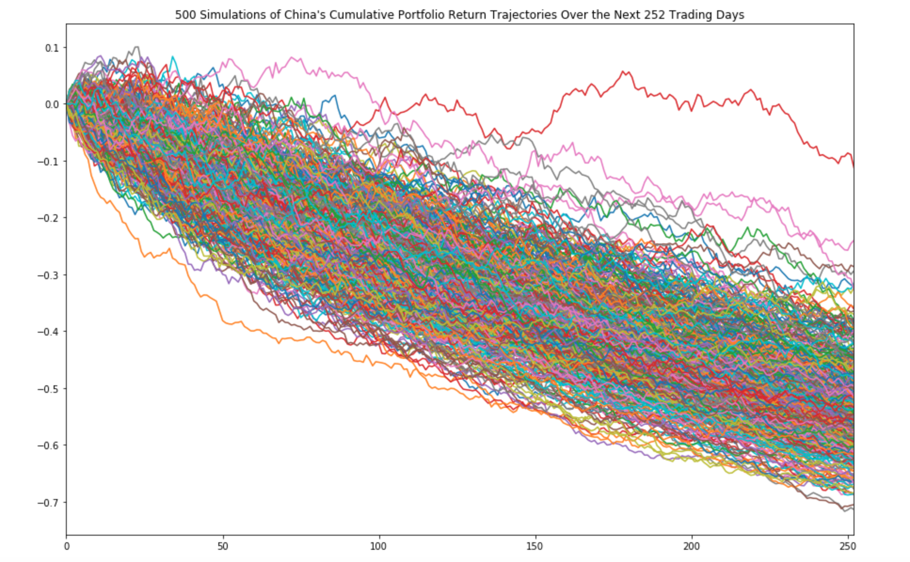
Montecarlos Simulations for China

Slide 23
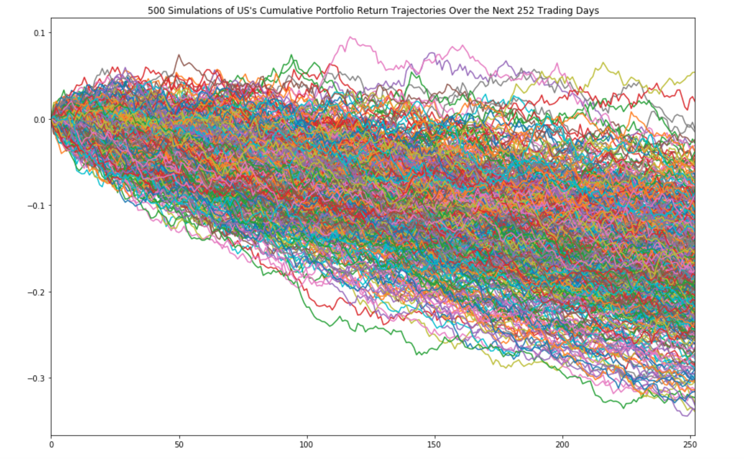
Montecarlos Simulations for US

